Slide 1

VISIONEXTRACT: ISOLATION FROM IMAGES USING IMAGE SEGMENTATION

Slide 2

ABSTRACT
Automated image segmentation pipeline developed for subject isolation using binary masks
COCO dataset explored and processed into pixel-level segmentation masks
1
Preprocessing pipeline including resizing, normalization, and augmentation
Accurate linking of images with annotations and verification of mask alignment
2
Dataset split into training and validation sets for model readiness
Visual results confirm correct subject isolation and preprocessing automation
3

Slide 3

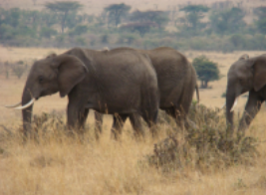
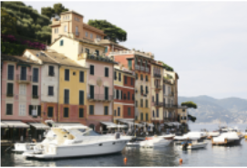
PROBLEM
STATEMENT
Proper preprocessing such as resizing, augmentation, and normalization is required to prepare consistent training data.
Real-world images contain complex scenes where isolating the main subject is challenging.
Manual segmentation and preprocessing of large image datasets is time-consuming and inefficient.
A structured pipeline is needed to convert raw image datasets into training-ready data for segmentation model development.
There is a need for an automated system to generate accurate segmentation masks from annotated datasets.

Slide 4


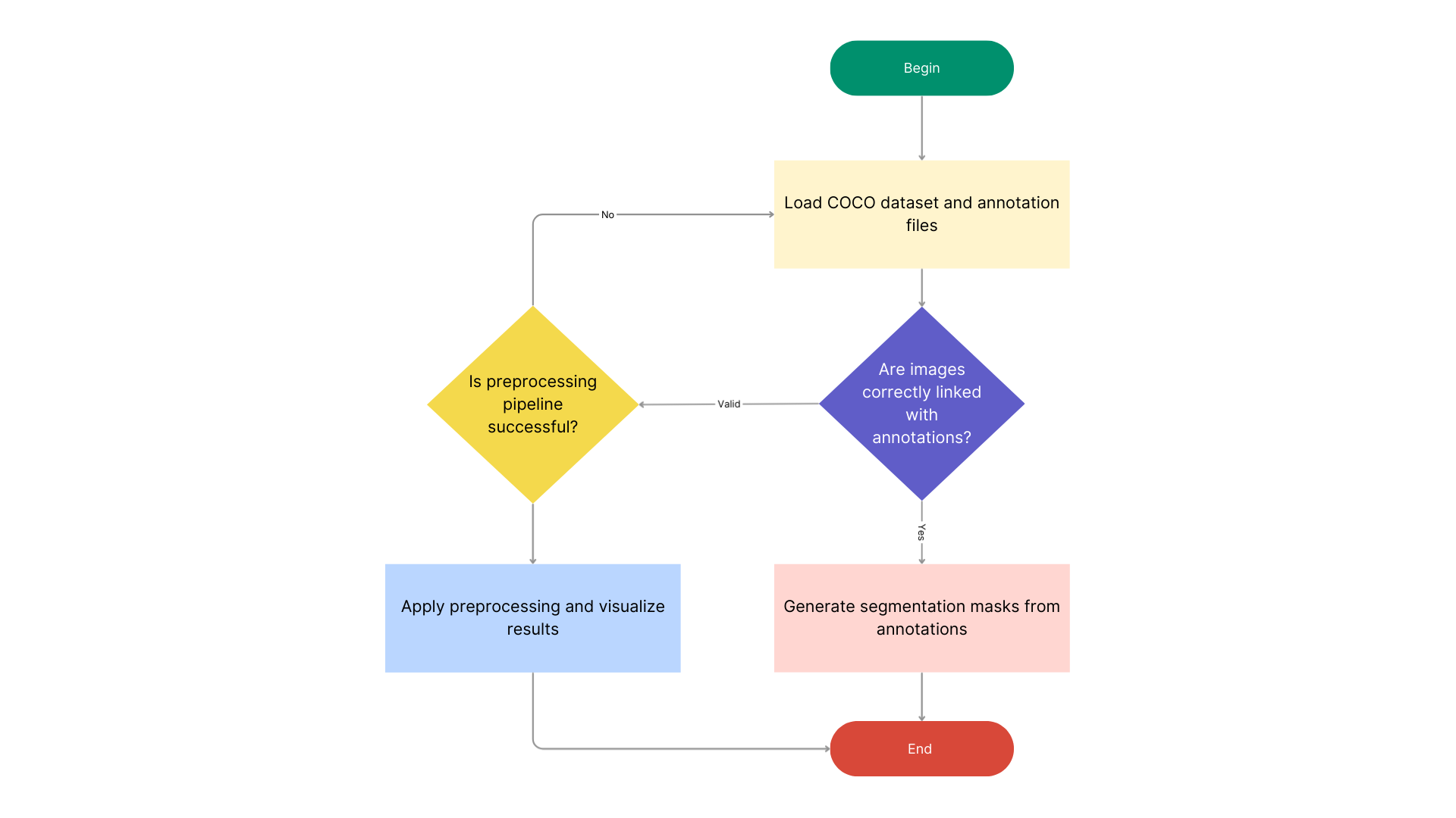
USE CASE
DIAGRAM
• The system loads the dataset and annotation files.
• It checks whether images are correctly linked with annotations.
• If valid, segmentation masks are generated.
• The preprocessing pipeline is executed and verified.
• Processed results are visualized and saved to complete Milestone 1.

Slide 5


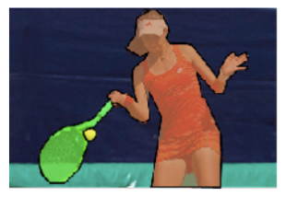
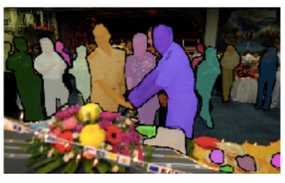
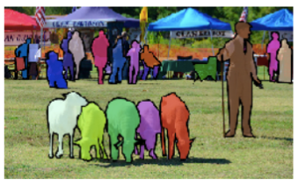
DATASET
EXPLORATION
• The project uses the COCO 2017 segmentation dataset containing over 200,000 labeled images with object segmentation annotations.
• The dataset includes 80 object classes such as person, car, bicycle, animals, and common everyday objects.
• It consists of image folders and JSON annotation files storing class labels, image metadata, and polygon segmentation coordinates.
• Dataset structure and class distribution were analyzed by inspecting annotation categories and folder organization.
• Sample images, class labels, and corresponding masks were visualized to study segmentation quality.
• Image–annotation alignment was verified to ensure accurate mask generation.

Slide 6


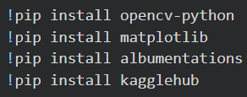
PACKAGES USED
ENVIRONMENT USED
• NumPy: Used for array operations and mask processing during preprocessing.
• OpenCV: Used for image loading, resizing, and mask generation.
• Matplotlib: Used to visualize images and segmentation results.
• Albumentations: Used for data augmentation such as flipping and brightness adjustments.
• JSON: Used to read and handle annotation files.
• OS: Used for file and folder management.
• Random: Used for dataset sampling and splitting.
• KaggleHub / Dataset Tools: Used to download and manage the dataset.
The project was developed and executed using Google Colab, a cloud-based Python notebook environment that provides GPU support, pre-installed machine learning libraries, and seamless integration for dataset handling and visualization.
ENVIRONMENT SETUP AND PACKAGE INSTALLATION

Slide 7
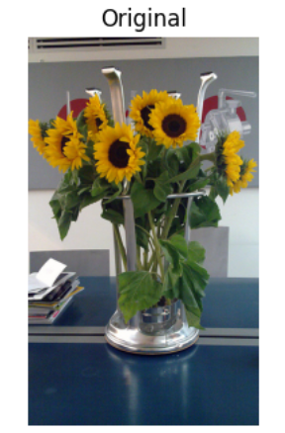
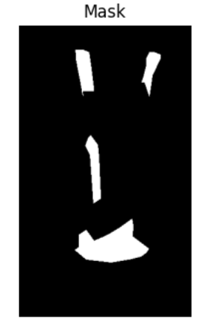
AUTOMATED
SUBJECT ISOLATION
• Automatically detects the main subject in an image.
• Extracts the subject while removing the background.
• Sets all non-subject pixels to black.
• Produces a clean cutout image of the original subject.
• Supports image editing and media processing workflows.

Slide 8
MILESTONE 1
TASKS TO BE COMPLETED
Week 1: Project Initialization and Dataset Acquisition
• Define project objectives and expected results.
• Acquire and inspect an appropriate image segmentation dataset with subject mask annotations.
• Explore dataset structure and view example images and masks.
Week 2: Data Preprocessing and Validation
• Develop a preprocessing pipeline (resize, normalization, augmentation).
• Ensure correct alignment of images and annotated masks.
• Convert multi-class masks (if present) into binary masks identifying only the main subject.

Slide 9
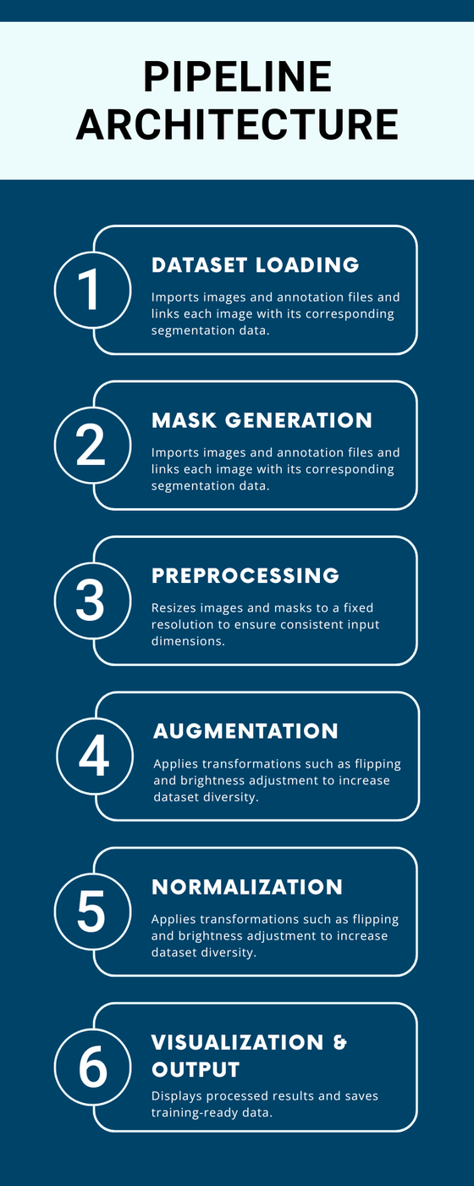
PIPELINE
ARCHITECTURE
• Dataset Loading Module: Imports images and annotation files and links each image with its corresponding segmentation data.
• Mask Generation Module: Converts polygon annotations into pixel-level segmentation masks for subject extraction.
• Preprocessing Module: Resizes images and masks to a fixed resolution to ensure consistent input dimensions.
• Augmentation Module: Applies transformations such as flipping and brightness adjustment to increase dataset diversity.
• Normalization Module: Scales image pixel values and converts masks into binary format.
• Visualization & Output Module: Displays processed results and saves training-ready data for future model development.

Slide 10

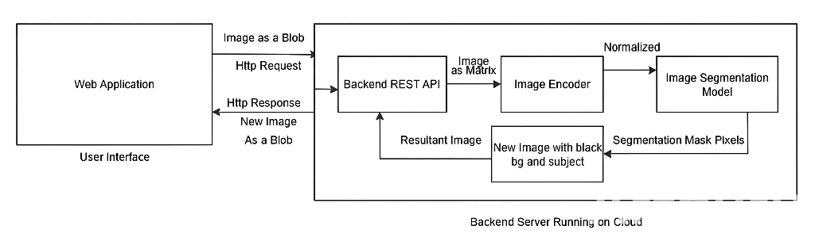
MODEL
ARCHITECTURE
• The model uses an encoder–decoder segmentation architecture to isolate the subject.
• The encoder extracts high-level features using convolution and pooling layers.
• A bottleneck layer captures deep semantic information.
• The decoder reconstructs the image to produce pixel-level masks.
• Skip connections preserve spatial details and improve accuracy.

Slide 11
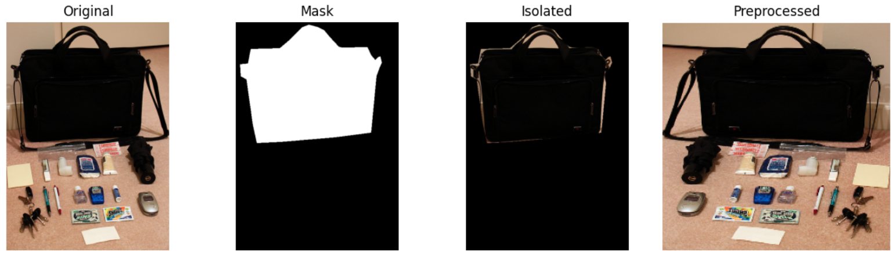
RESULTS
SUBJECT ISOLATION AND PREPROCESSING
• Successfully generated segmentation masks from dataset annotations.
• Verified correct alignment between original images and masks.
• Applied preprocessing pipeline including resizing, normalization, and augmentation.
• Demonstrated subject isolation using binary masks.

Slide 12
CHALLENGES FACED
SOLUTIONS
• Challenge: Understanding the dataset structure and annotation format.
Solution: Explored JSON files and visualized sample images with masks to verify structure.
• Challenge: Incorrect alignment between images and segmentation masks.
Solution: Implemented validation checks and visual comparisons to ensure proper mapping.
• Challenge: Handling multi-class segmentation annotations.
Solution: Converted masks into binary format focusing only on the main subject.
• Challenge: Building a consistent preprocessing pipeline.
Solution: Developed an automated pipeline for resizing, normalization, and augmentation.
• Challenge: Managing large dataset files in the environment.
Solution: Organized folders and used efficient loading and sampling techniques.

Slide 13
REAL WORLD APPLICATIONS
FUTURE SCOPE
Real World Applications
• Background removal and photo editing in media and design tools.
• Autonomous driving systems for object and scene understanding.
• Medical image analysis for isolating regions of interest.
• Surveillance and security systems for object detection.
• Augmented reality applications for real-time subject segmentation.
Future Scope
• Training advanced deep learning models for higher segmentation accuracy.
• Expanding the system to multi-class segmentation tasks.
• Real-time deployment in mobile and edge devices.
• Integration with AI-powered image and video editing tools.
• Optimization for large-scale datasets and faster processing.

Slide 14
MILESTONE 1
SUMMARY AND CONCLUSION
• Project Initialization Completed: Defined objectives and expected results, and acquired the COCO 2017 dataset with annotated images.
• Dataset Exploration: Explored dataset structure, inspected image–annotation pairs, and visualized sample images and masks.
• Preprocessing Pipeline Implemented: Automated pipeline developed for resizing, normalization, augmentation, and binary mask conversion.
• Subject Isolation Achieved: Successfully isolated subjects from images using generated masks, verifying correct alignment and mask accuracy.
• Training-Ready Data Prepared: Dataset split into training and validation sets, ensuring ready-to-use data for segmentation model development.
• Challenges Overcome: Addressed annotation complexity, alignment issues, multi-class masks, and large dataset management through validation, automation, and structured file handling.
• Conclusion: Milestone 1 successfully established a robust, automated preprocessing system and prepared high-quality, standardized data for the next phase of model training and segmentation development.

Slide 15

THANK YOU

